Slide 1
Zomato data Analysis
Presenting by group 1

Slide 2
Introduction of Zomato
Launched in 2010, Our technology platform connects customers, restaurant partners and delivery partners, serving their multiple needs. Customers use our platform to search and discover restaurants, read and write customer generated reviews and view and upload photos, order food delivery, book a table and make payments while dining-out at restaurants. On the other hand, we provide restaurant partners with industry-specific marketing tools which enable them to engage and acquire customers to grow their business while also providing a reliable and efficient last mile delivery service. We also operate a one-stop procurement solution, Hyperpure, which supplies high quality ingredients and kitchen products to restaurant partners. We also provide our delivery partners with transparent and flexible earning opportunities.

Slide 3
Project Members
Rushikesh Gaikwad
Komal
Pranjal
Vikas
Abhishek
Sejal
Sai

Slide 4
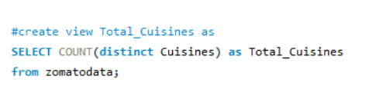

Total Cuisines
Zomato restaurants have different types of Cuisines. As people expect different types of food as they belongs to different types of region. Zomato restaurants offer 1826 Types of Cuisines in their business.

Slide 5
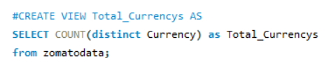

Total currency's
Zomato is providing Delivery for their all region and they are offering transactions in 12 different types of currencies to provide a better services to their Customers in the available locations.

Slide 6

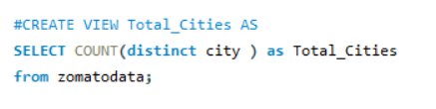

Total cities
Zomato is providing delivery from their restaurants in the world. And they are operating their business in total 141 cities in the world.

Slide 7



Total votes
Zomato is doing their business across world and they have received appreciation from their customers as votes they have received about 1498645.

Slide 8



Total countries
Zomato is doing their business across world. Operating in total 15 Countries.

Slide 9



Total restaurants
Zomato is operating with 9551 locations

Slide 10



Total localities
Zomato is operating with 9551 locations

Slide 11
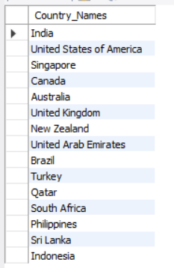

all countries
Zomato is operating total 12 countries with India

Slide 12


Average ratings
Zomato restaurants are available in different and received 2.93 average rating across world.

Slide 13
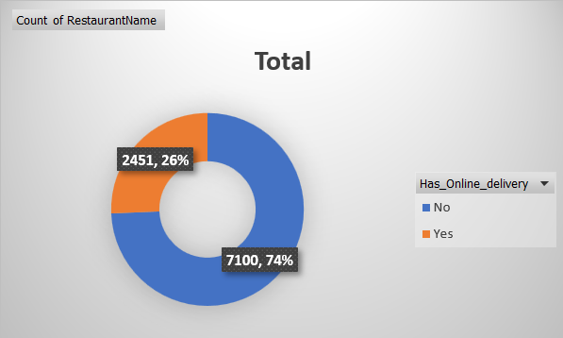

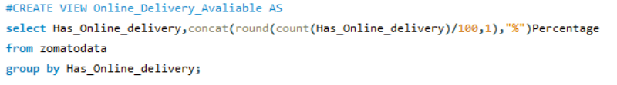
Online delivery available
Zomato restaurants offers Online delivery option for their global customers which falls around 24.5% and 71.0% restaurant still don’t offer online delivery option.

Slide 14
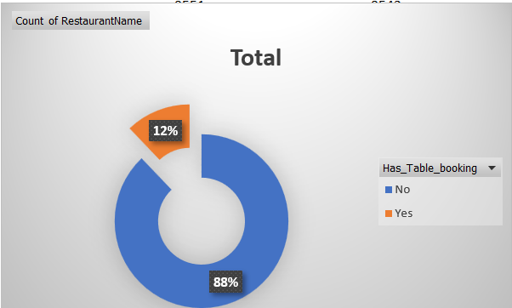

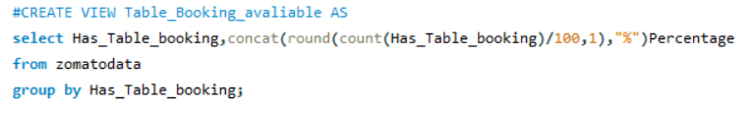
Table booking available
Zomato restaurants offers Table Booking option for their Global customers and which falls under 11.6% restaurants in that range and 83.9% restaurants still don’t offer table booking option.

Slide 15
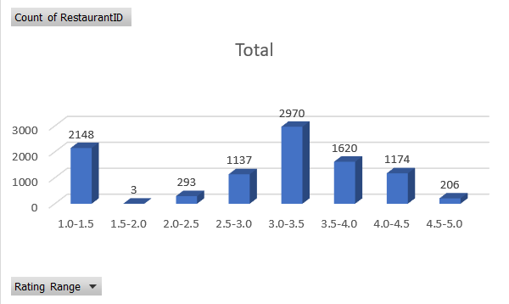
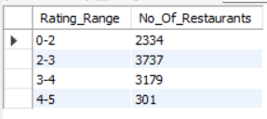
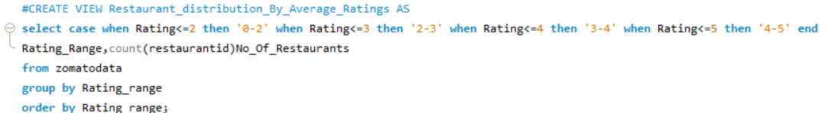
Restaurant distribution by average ratings
Restaurant distribution as per rating range in Zomato as there are 2334 restaurants received 0-2 rating and 3737 restaurants received 2-3 rating, 3179 restaurants received 3-4 ratings, 301 restaurants received 4-5 rating which is consider as top rating in this.

Slide 16
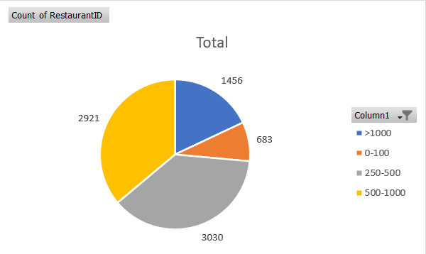
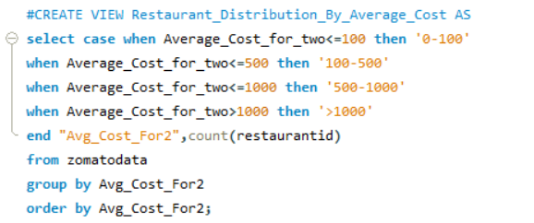
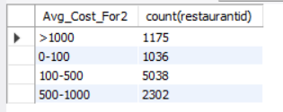
Restaurant distribution by average cost
Zomato restaurants distribution by average cost of 0-100 there are 683 restaurants are in this segment, 3030 restaurants are falling in 250-500 segment, 2921 restaurants are falling in 500-1000 segment and 1456 restaurants are falling more than 1000 average cost.

Slide 17
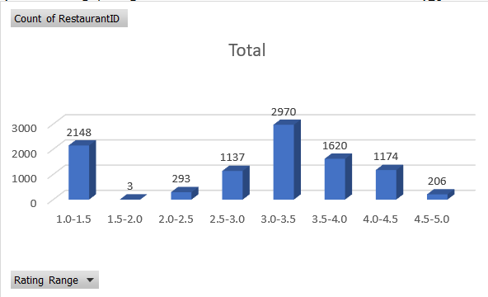
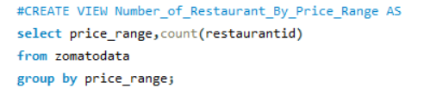
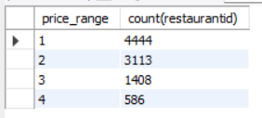
Number of restaurant by price range
Number of Restaurants by price range 4444 restaurants are falling under 1 price range category which is lower price range and 3113 restaurants are falling under 2 price range category, 1408 restaurants are falling under 3 price range category, 586 restaurants are falling under 4 price range category with consider as higher range of price.

Slide 18
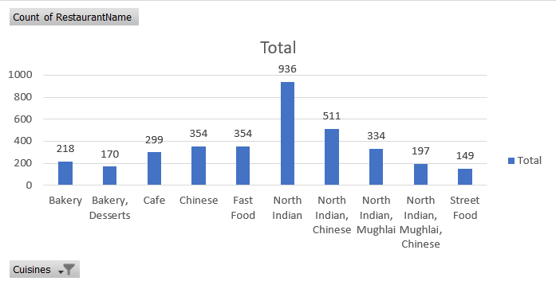
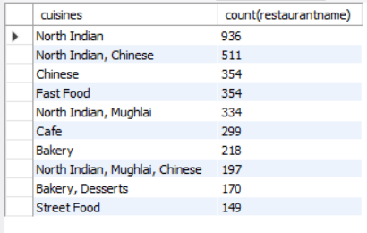
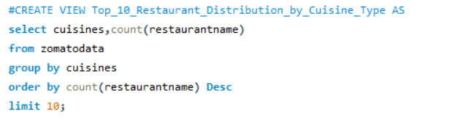
Top 10 restaurant distribution by cuisine types
Top 10 restaurant by cuisines types are most liked restaurant food are north Indian food which operated in 936 restaurant which comes on 1 choice of people and second with 511 restaurants chiness are gatting on second choice of people, fallowed by fast food, Mughlai, Café, Bakery, Street food which is last in the list with 149 restaurants.

